Slide 1
Sequence Similarity through Shingling

Slide 2
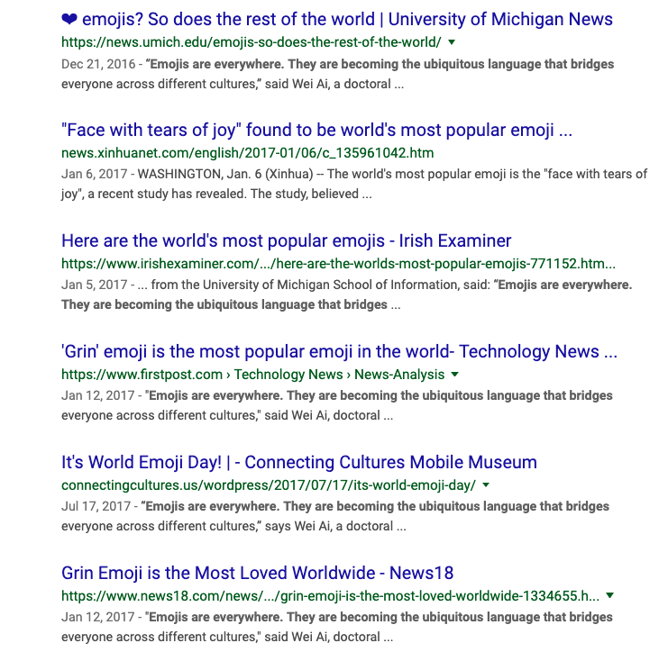
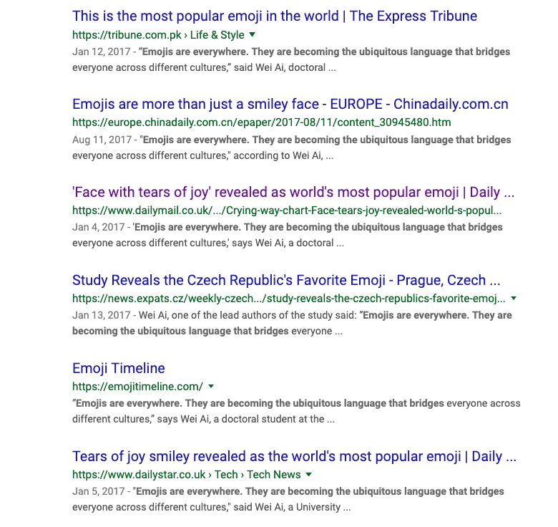

Application: near-duplicates
Emojis - Twitter - https://twemoji.twitter.com/content/twemoji-twitter/en.html - CC-BY 4.0

Slide 3
Application: near-duplicates
30% of web pages are near-duplicates (Broder et al. 1997)
mirrors, local copies, page updates
spam, spider-traps
crawling errors
Detect near-duplicates and remove them from index (with limited time & space cost)

Slide 4
Challenge
Strict duplication is easy to handle (use hashing), but what about near-duplication?
Similar problem: plagiarism detection
Need a fast measurement of sequence similarity (for long sequences)

Slide 5
Shingling (Broder et al., 1997)
Represent a sequence as a set of overlapping ngrams
“to be or not to be” →
{“to be or”,
“be or not”,
“or not to”,
“not to be”}

Slide 6
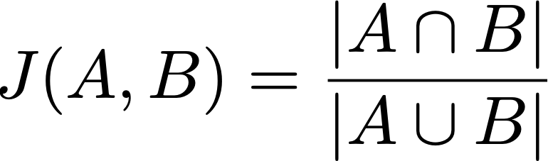
Shingling
Then sequence similarity is Jaccard similarity of two sets

Slide 7
Example
X = “to be or not to be”
Y = “not be or not to be”
X’: {“to be or”, “be or not”, “or not to”, “not to be”}
Y’: {“not be or”, “be or not”, “or not to”, “not to be”}
sim(X, Y) = J(X’, Y’) = 3/5

Slide 8
Example
X = “to be or not to be”
Y = “not be or not to be”
Z = “be or not to not be”
X’: {“to be or”, “be or not”, “or not to”, “not to be”}
Y’: {“not be or”, “be or not”, “or not to”, “not to be”}
Z’: {“be or not”, “or not to”, “not to not”, “to not be”}

Slide 9
Example
X = “to be or not to be”
Y = “not be or not to be”
Z = “be or not to not be”
X’: {“to be or”, “be or not”, “or not to”, “not to be”}
Y’: {“not be or”, “be or not”, “or not to”, “not to be”}
Z’: {“be or not”, “or not to”, “not to not”, “to not be”}
sim(X, Y) = J(X’, Y’) = 3/5
sim(X, Z) = J(X’, Z’) = 2/6

Slide 10
Advantages of Shingling
Fast: O(m + n) to compare two sequences
Bounded between [0, 1]
Can be further speeded up using random projection algorithms
Minhash
Locality sensitive hashing

Slide 11
Limitations of Shingling
Set approximation may not be accurate
Size of shingles matter
Variations of algorithms try to estimate other similarity functions (e.g., Weighted Jaccard, Euclidean distance)

Slide 12
What you should know
How to compute sequence similarity
Edit distance and how it is calculated
How shingling works
Applications of sequence similarity

Slide 13


School of Information, University of Michigan
Qiaozhu Mei
School of Information
All Content © Presenter

